Slide 1
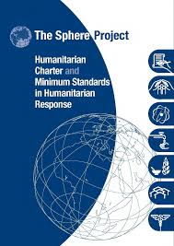
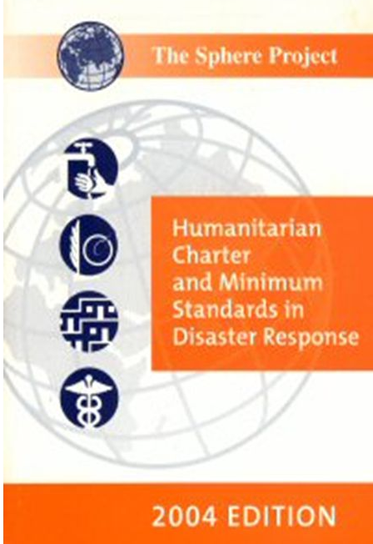

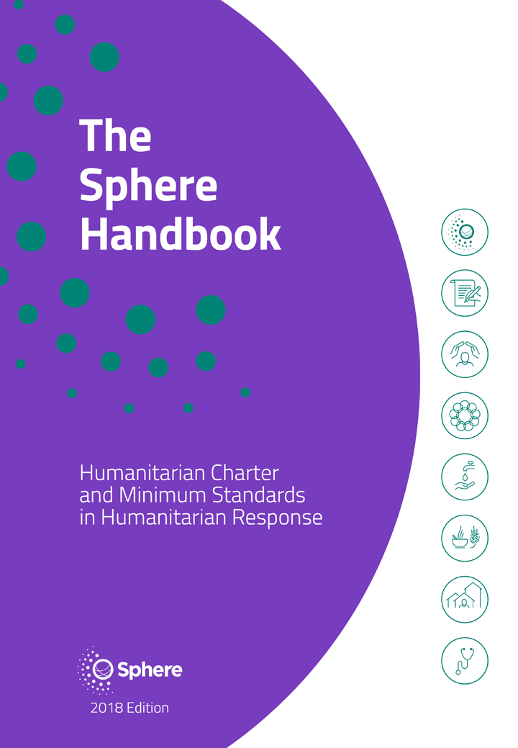
What is Sphere?
The Sphere Project was created in 1997 by humanitarian NGOs and the International Red Cross and Red Crescent Movement to improve the quality of humanitarian response and to be more accountable for their actions.
2000
2004
2011
2018
Notes:
If you didn’t use STP session 1 (Welcome and Introduction), then spend a little extra time here to cover the key points from slides 12 (“The Sphere movement”) and 13 (“How it all began…”), i.e. the Rwanda genocides in 1994, Danida and the JEEAR.

Slide 2

Sphere – the big picture
Notes:
Show the short video and ask participants what key points they take away from it.
These should include:
The concept of dignity
Guidance on doing the right thing at the right time
The cornerstone is the Humanitarian Charter
Regularly updated every few years to reflect changes in the field
Communities and people affected by crises are at the heart of their own recovery
Quality and accountability promote dignity

Slide 3
The Sphere philosophy
The Sphere philosophy is based on two core beliefs:
1. People affected by disaster or conflict have the right to life with dignity and, therefore, the right to assistance.
2. All possible steps should be taken to alleviate human suffering arising out of disaster or conflict.
Notes:
If you used STP session 1 then this is a reminder and a revisit.
Ask participants for their definition of dignity. If there isn’t clarity on this, call for examples (in lieu of a definition) of programmes where dignity was preserved, or where it was diminished in humanitarian response.
Note that most dictionary definitions include language such as “the state or quality of being worthy of honour or respect” or “a sense of pride in oneself; self-respect”. This can be quite nuanced. In one sense dignity is self-defined – humanitarians can neither bestow it nor remove it, however we endeavour to treat people with honour and respect.
If the participants do not have adequate examples to share, these could be offered:
Providing shelter from the sun and distributing water to beneficiaries while they are waiting in line to receive hygiene kits
Providing people cash to buy the food they prefer (and decide to buy) instead of providing in-kind dried rations
At a registration centre, providing child-friendly spaces so their time and interests are respected

Slide 4

The Sphere Handbook – eight interdependent chapters
What is Sphere?
The Humanitarian Charter
Protection Principles
Core Humanitarian Standard
Water Supply, Sanitation and Hygiene Promotion (WASH)
Food Security and Nutrition
Shelter and Settlement
Health
FOUNDATION
CHAPTERS
TECHNICAL
CHAPTERS
Notes:
The key point of this slide is to highlight the fundamental point that informed use of Sphere means the use of all of Sphere – not just the four technical chapters if you are a field worker, and not just the foundation chapters if you are a protection officer.

Slide 5
General structure of the Sphere Standards*
Introduction including “essential concepts”
Links with other standards
THE STANDARDS
Key actions
Key indicators
Guidance notes
*The CHS chapter has a structure comparable with the technical chapters.
Appendices
References and further reading
Notes:
Refer participants to the second half of the Handbook – the four technical chapters. Call for a show of hands of people who have used information from these chapters in their work. Call for a few examples. Briefly explain the overall structure of the technical chapters using the diagram as a guide.

Slide 6
The Code of Conduct: 10 Core Principles
The humanitarian imperative comes first.
Aid is given regardless of the race, creed or nationality of the recipients and without adverse distinction of any kind. Aid priorities are calculated on the basis of need alone.
Aid will not be used to further a particular political or religious standpoint.
We shall endeavour not to act as instruments of government foreign policy.
We shall respect culture and custom.
See page 6
6
Notes:
Explain that the Code of Conduct is one of the oldest products of a quality and accountability initiative that is still in wide use. It is considered a direct supporting component of the Humanitarian Charter (and therefore the Sphere Handbook) and it reflects many of the same values found elsewhere in the Sphere Handbook. Explain that this code is quite specific, and is often difficult to follow to the letter or to follow in all aspects.
Note the Code of Conduct Principles are listed on page 6 and the full code is presented in Annex 2 starting on page 385.
Ask participants what the humanitarian imperative is. Answer: “Action should be taken to prevent or alleviate human suffering arising out of disaster or conflict”. Note the similarity and difference to the second core belief of Sphere philosophy (page 4): “All possible steps should be taken to alleviate human suffering arising out of disaster or conflict.”
Ask participants to stand up and to move around the room to quickly tour the 10 prepared posters (A3 sheets with one principle printed on each). This kind of activity may be referred to as a “gallery walk”.

Slide 7
The Code of Conduct: 10 Core Principles
We shall attempt to build disaster response on local capacities.
Ways shall be found to involve programme beneficiaries in the management of relief aid.
Relief aid must strive to reduce future vulnerabilities to disaster as well as meeting basic needs.
We hold ourselves accountable to both those we seek to assist and those from whom we accept resources.
In our information, publicity and advertising activities, we shall recognise disaster victims as dignified human beings, not hopeless objects.
Notes:
Continues the list of the 10 principles of the Code of Conduct.

Slide 8

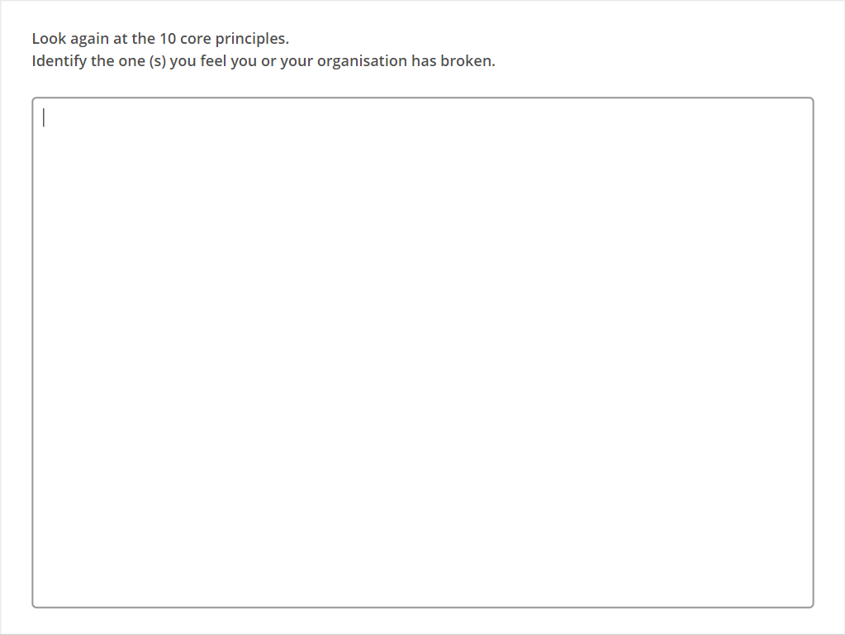
Quiz
Click the Quiz button to edit this object
Notes:
After a few minutes of “touring” the posters, ask participants to move to any one of the principles they believe that they (or their organisation) have failed to uphold in a particular instance (or where there was significant debate about the point). If there is more than one person at the same poster, ask them to briefly exchange information on their situations. This will take 3 to 5 minutes. When the time has run out (or the discussion in the room has gone quiet), ask them to react to question 3 on the slide – How can organisations work to better follow the specific principle?
Final debriefing of this question will take another 5 to 10 minutes.

Slide 9
Key messages
People affected by crises have the right to life with dignity and to assistance.
The Humanitarian Charter is the cornerstone of the Sphere approach and Handbook
The foundation chapters and the technical chapters of the Handbook are two halves of one approach. Both are integral to each other and to ensuring quality humanitarian response.
Understanding the overall structure of the Handbook, and the use of its different components, is critical to using it effectively.

Slide 10
You should now be ready to use the Sphere Handbook as an informed user!
Notes:
Thank everyone for their attention and note the return time if there is a follow-on session.

